Slide 1
Computational Chemistry
Lecture 4: Practical Aspects of Electronic Structure -- Examples

Slide 2
Before a calculation, have to specify:
1. Identity of atoms
2. Positions of atoms (distances, angles, . . .)
3. (spin multiplicity)
4. Exact theoretical model (how are Coulomb, exchange, and correlation described?)
(a) Hartree, Hartree-Fock, DFT, . . .
5. Basis set to express wavefunctions
6. Initial guess of wavefunction coefficients (often guessed for you)

Slide 3
During the calculation: SCF Iterative Procedure
Example: HF method
Given a basis set, calculate one-electron and two-electron integrals
Make an initial guess at coefficients
Solve the HFR equations to obtain energies
Use energise to obtain another set of coefficients
Use new coefficients to obtain new energies
Compare sets of energies: if the difference is not less than tolerance, do another cycle

Slide 4
After the calculation: Output
1. Energies of molecular orbitals
2. Occupancies of molecular orbitals
3. Coefficients describing molecular orbitals
4. Total electron wavefunction, total electron density, dipole moment, . . .
5. Total molecular energy
6. Derivatives (“gradients”) of total energy w.r.t. atom positions

Slide 5
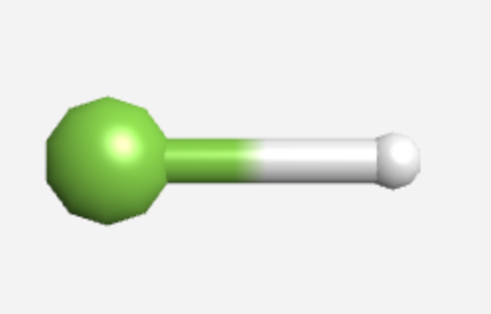
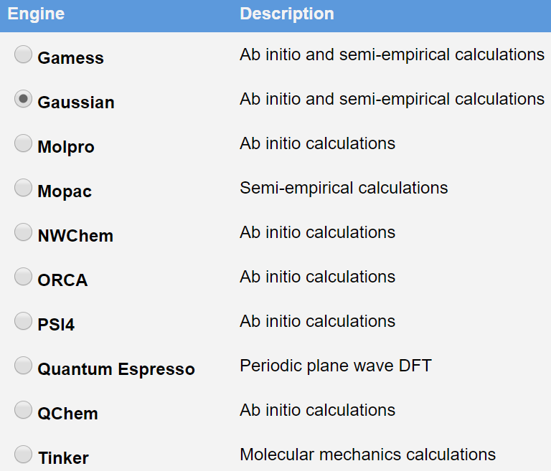
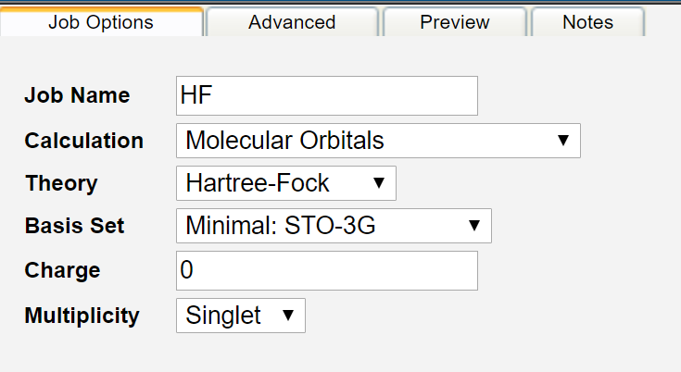
Example: HF (using webmo)
Input: Bond length = 0.95 angstroms, Gaussian,…

Slide 6
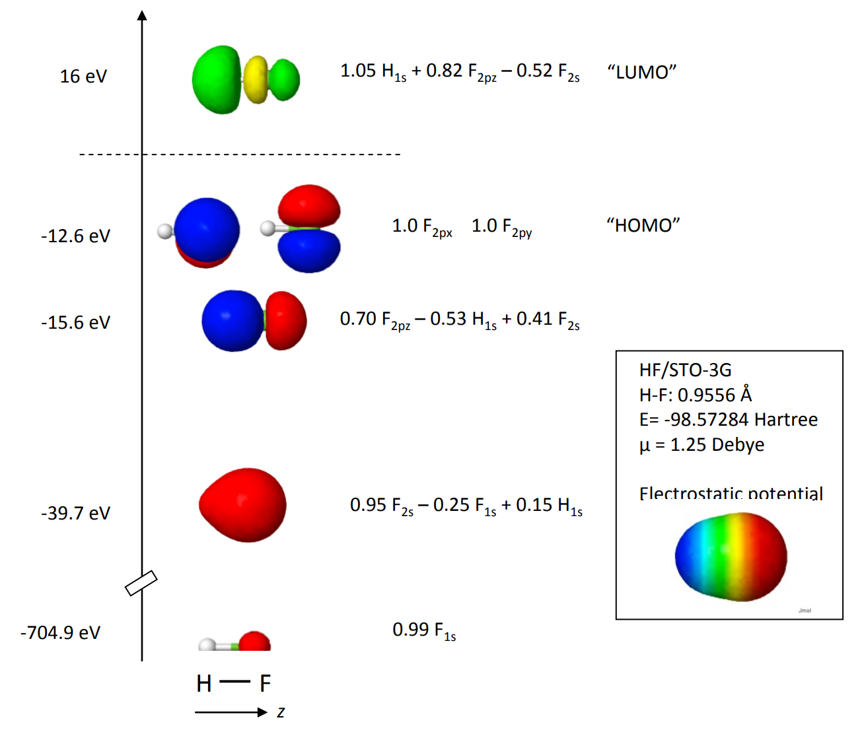
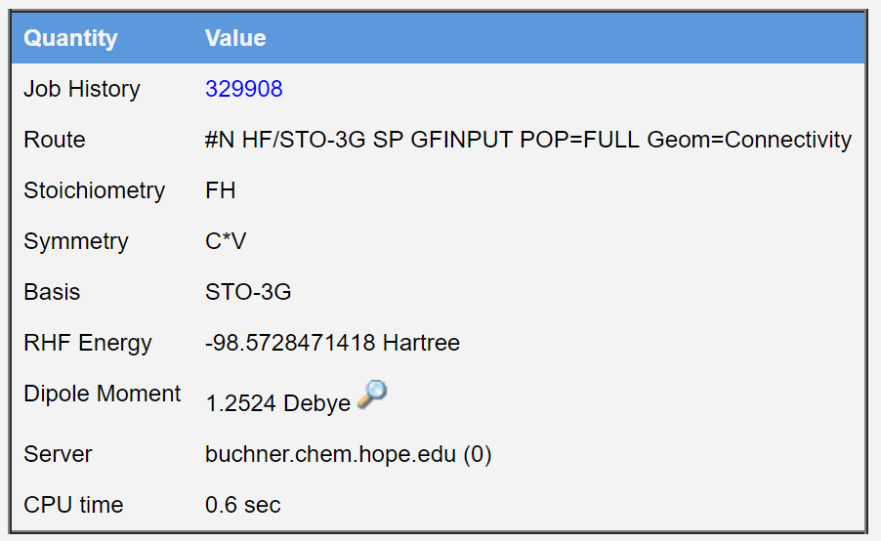
Example: HF (using webmo)
Output: E = -98.57 Ha,…

Slide 7
Example: HF (using webmo)
Using different basis:
STO-3G: 6 basis functions, 18 primitive gaussians, E(RHF) = -98.5728 Ha
3-21G: 11 basis functions, 18 primitive gaussians, E(RHF) = -99.4599 Ha
6-31G(d): 17 basis functions, 32 primitive gaussians, E(RHF) = -100.0008 Ha
6-311+G(2d,p): 33 basis functions, 50 primitive gaussians, E(RHF) = -100.0505 Ha

Slide 8
Choosing basis sets: Rules of thumb
More basis functions are generally better than fewer. Trick is to add basis flexibility in regions you care about.
Consider nature of problem at hand. Structures, dipole moments, vibrational frequencies can generally be captured with modest basis. Accurate absolute bond or excited state energies may require larger bases. NMR requires good cover near the core region.
Personal experience, literature, and convention. In general, careful use means the user tests the sensitivity of computed results to basis set (and other approximations).
Computational resources ultimately dictate what you are able to do.

